Slide 1
Software Development Lifecycle

Slide 2
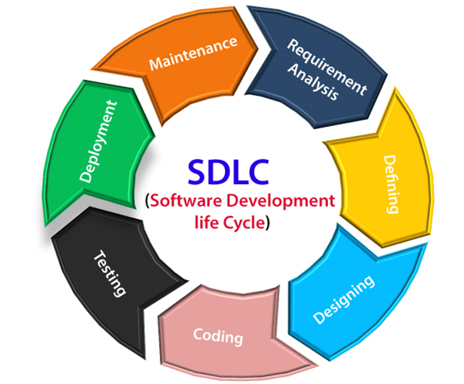
SDLC
Notes:
Pictorial representation of software lifecycle
Refers to methodology with clearly defined processes for creating high quality software.

Slide 3
1. Requirement Analysis
Inputs from stack holders, domain experts
Planning for quality assurance requirements
Identification of the risks
What customer wants to build ?
Who will be the end user ?
What is the objective ?

Slide 4
2. Defining Requirements
Represent and Document the software requirements
Software Requirement Specification document containing all the requirements.

Slide 5
3. Designing the software
SRS is taken for reference
Architecture is designed and documented in DDS.
Best design approach is selected.
Approach clearly defines
All architectural modules
Communication and Dataflow representations with 3rd party / external modules
Notes:
Best design approach is selected based on various parameters like risk assessment, design modularity, budget, or time constraint.

Slide 6
4. Building / Coding / Developing
Actual Development starts
Program is written
Follow guidelines and design
Notes:
Programmers need to follow programming guide lines defined, and follow design previously developed

Slide 7
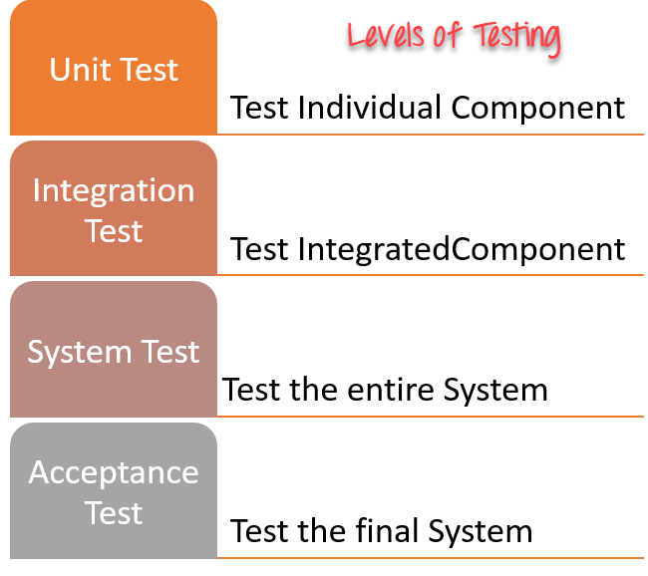
5. Testing
Are products solving needs addressed during requirement analysis ?
Notes:
After the code is generated, it is tested against the requirements to make sure that the products are solving the needs addressed and gathered during the requirements stage.
During this stage, unit testing, integration testing, system testing, acceptance testing are done.

Slide 8
6. Deployment
After software is tested
Sometimes it happens in stages
Notes:
Sometimes it happens in stages as per business stratergy

Slide 9
7. Maintenance
After software is deployed, maintenance begins
Real issues comes up in deployed systems.

Slide 10
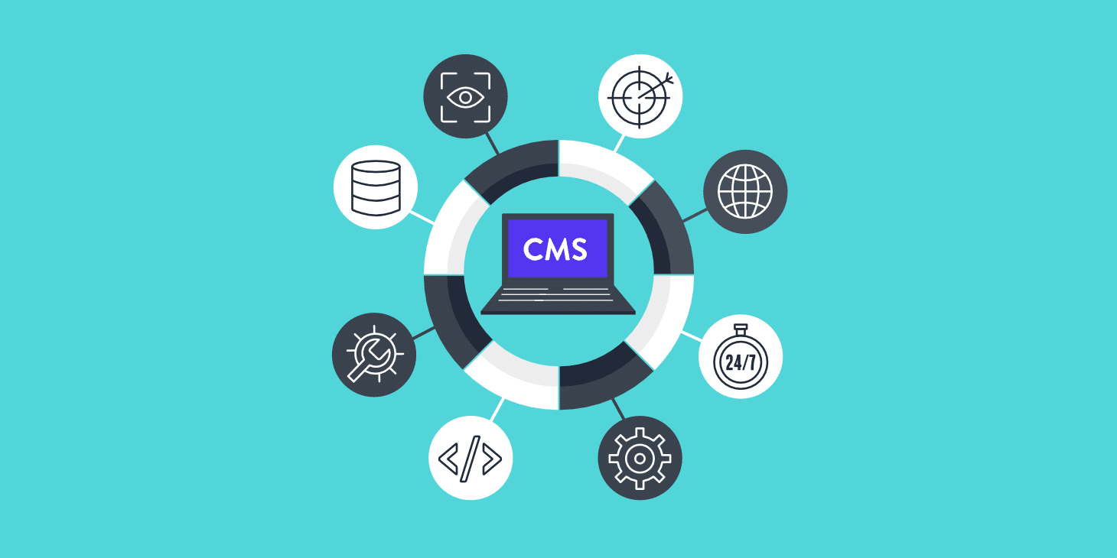
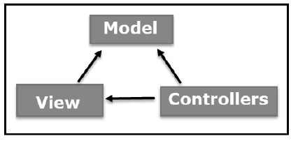
CMS vs. MVC

Slide 11
CMS vs. CS
CMS
MVC
Software that helps users create, manage and modify content on website without the need for specialized technical knowledge
Model View Controller – is an architectural pattern which separates and application into three main logical components, the model, the view and the controller.

Slide 12
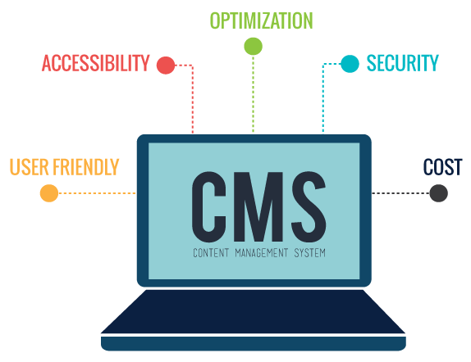

CMS vs. CS
CMS
MVC
Notes:
Hard to use for non professional
CMS is more of a tool, like for building a website, you may not need any coding skill at all .

Slide 13


CMS vs. CS
CMS
MVC
Notes:
CMS is backed by community, providing you with new features, bug fixes, plugins, themes, and modules.
But in MVC, bug fixes, or adding / creating new modules well have to be done by the developer who want that thing.

Slide 14


CMS vs. CS
CMS
MVC
Notes:
expensive - in most cases you/your client will need much more money for a custom app
further maintenance will be harder
changes and modifications of the structure can be very time consuming

Slide 15


CMS vs. CS
CMS
MVC
Notes:
We can create more customized applications using mvc, where as in cms, if our requirements are very specific, then we’ll have to override the default workflow, which can be tricky .

Slide 16
CMS vs. CS
CMS
MVC

Slide 17




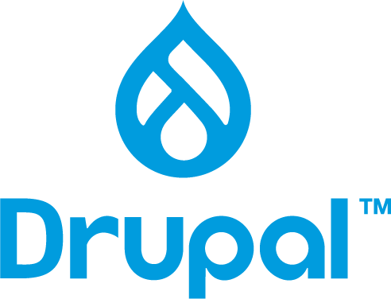
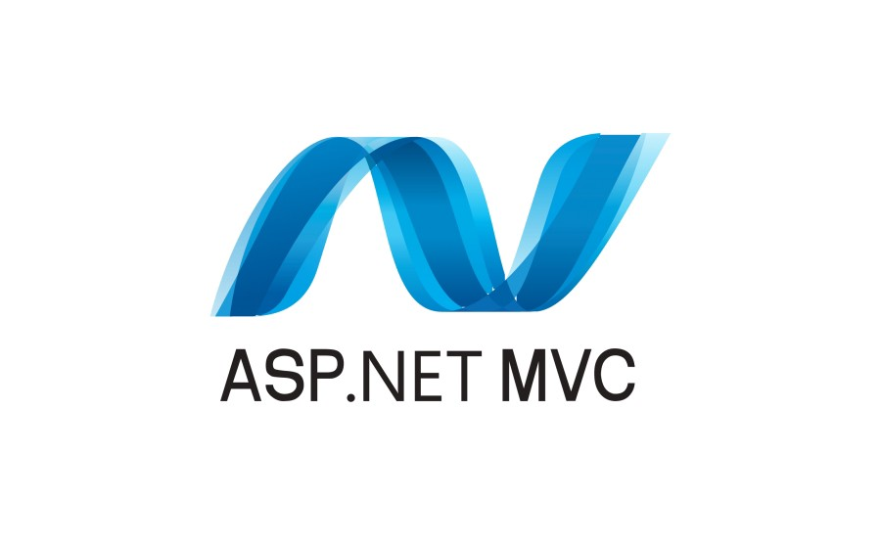


CMS vs. CS
CMS
MVC

Slide 18
THANK YOU!

